Slide 1

Training R-CNNs of various velocities Slow, fast, and faster
Ross Girshick
Facebook AI Research (FAIR)
Tools for Efficient Object Detection, ICCV 2015 Tutorial

Slide 2
Section overview
Kaiming just covered inference
This section covers
A brief review of the slow R-CNN and SPP-net training pipelines
Training Fast R-CNN detectors
Training Region Proposal Networks (RPNs) and Faster R-CNN detectors

Slide 3
Review of the slow R-CNN training pipeline
Steps for training a slow R-CNN detector
[offline] M ⃪ Pre-train a ConvNet for ImageNet classification
M’ ⃪ Fine-tune M for object detection (softmax classifier + log loss)
F ⃪ Cache feature vectors to disk using M’
Train post hoc linear SVMs on F (hinge loss)
Train post hoc linear bounding-box regressors on F (squared loss)
R Girshick, J Donahue, T Darrell, J Malik. “Rich Feature Hierarchies for Accurate Object Detection and Semantic Segmentation”. CVPR 2014.

Slide 4
Review of the slow R-CNN training pipeline
“Post hoc” means the parameters are learned after the ConvNet is fixed
[offline] M ⃪ Pre-train a ConvNet for ImageNet classification
M’ ⃪ Fine-tune M for object detection (softmax classifier + log loss)
F ⃪ Cache feature vectors to disk using M’
Train post hoc linear SVMs on F (hinge loss)
Train post hoc linear bounding-box regressors on F (squared loss)
R Girshick, J Donahue, T Darrell, J Malik. “Rich Feature Hierarchies for Accurate Object Detection and Semantic Segmentation”. CVPR 2014.

Slide 5
Review of the slow R-CNN training pipeline
Ignoring pre-training, there are three separate training stages
[offline] M ⃪ Pre-train a ConvNet for ImageNet classification
M’ ⃪ Fine-tune M for object detection (softmax classifier + log loss)
F ⃪ Cache feature vectors to disk using M’
Train post hoc linear SVMs on F (hinge loss)
Train post hoc linear bounding-box regressors on F (squared loss)
R Girshick, J Donahue, T Darrell, J Malik. “Rich Feature Hierarchies for Accurate Object Detection and Semantic Segmentation”. CVPR 2014.

Slide 6
Review of the SPP-net training pipeline
The SPP-net training pipeline is slightly different
[offline] M ⃪ Pre-train a ConvNet for ImageNet classification
F ⃪ Cache SPP features to disk using M
M’ ⃪ M.conv + Fine-tune 3-layer network fc6-fc7-fc8 on F (log loss)
F’ ⃪ Cache features on disk using M’
Train post hoc linear SVMs on F’ (hinge loss)
Train post hoc linear bounding-box regressors on F’ (squared loss)
Kaiming He, Xiangyu Zhang, Shaoqing Ren, & Jian Sun. “Spatial Pyramid Pooling in Deep Convolutional Networks for Visual Recognition”. ECCV 2014.

Slide 7
Review of the SPP-net training pipeline
Note that only classifier layers are fine-tuned, the conv layers are fixed
[offline] M ⃪ Pre-train a ConvNet for ImageNet classification
F ⃪ Cache SPP features to disk using M
M’ ⃪ M.conv + Fine-tune 3-layer network fc6-fc7-fc8 on F (log loss)
F’ ⃪ Cache features on disk using M’
Train post hoc linear SVMs on F’ (hinge loss)
Train post hoc linear bounding-box regressors on F’ (squared loss)
Kaiming He, Xiangyu Zhang, Shaoqing Ren, & Jian Sun. “Spatial Pyramid Pooling in Deep Convolutional Networks for Visual Recognition”. ECCV 2014.

Slide 8
Why these training pipelines are slow
Example timing for slow R-CNN / SPP-net on VOC07 (only 5k training images!) using VGG16 and a K40 GPU
Fine-tuning (backprop, SGD): 18 hours / 16 hours
Feature extraction: 63 hours / 5.5 hours
Forward pass time (SPP-net helps here)
Disk I/O is costly (it dominates SPP-net extraction time)
SVM and bounding-box regressor training: 3 hours / 4 hours
Total: 84 hours / 25.5 hours

Slide 9
Fast R-CNN objectives
Fix most of what’s wrong with slow R-CNN and SPP-net
Train the detector in a single stage, end-to-end
No caching features to disk
No post hoc training steps
Train all layers of the network
Something that slow R-CNN can do
But is lost in SPP-net
Conjecture: training the conv layers is important for very deep networks (it was not important for the smaller AlexNet and ZF)
Ross Girshick. “Fast R-CNN”. ICCV 2015.

Slide 10
How to train Fast R-CNN end-to-end?
Define one network with two loss branches
Branch 1: softmax classifier
+
Branch 2: linear bounding-box regressors
Overall loss is the sum of the two loss branches
Fine-tune the network jointly with SGD
Optimizes features for both tasks
Back-propagate errors all the way back to the conv layers
Ross Girshick. “Fast R-CNN”. ICCV 2015.

Slide 11

Forward / backward
Log loss + smooth L1 loss
Multi-task loss
Proposal classifier
Linear +
softmax
Bounding box
regressors
Linear
FCs
RoI pooling
External proposal algorithm e.g. selective search
Trainable
ConvNet
(applied to entire image)

Slide 12
Benefits of end-to-end training
Simpler implementation
Faster training
No reading/writing features from/to disk
No training post hoc SVMs and bounding-box regressors
Optimizing a single multi-task objective may work better than optimizing objectives independently
Verified empirically (see later slides)
End-to-end training requires overcoming two technical obstacles
Ross Girshick. “Fast R-CNN”. ICCV 2015.

Slide 13
Obstacle #1: Differentiable RoI pooling
Region of Interest (RoI) pooling must be (sub-)differentiable to train conv layers
Ross Girshick. “Fast R-CNN”. ICCV 2015.

Slide 14
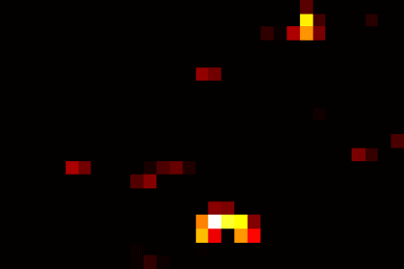

Review: Spatial Pyramid Pooling (SPP) layer
From Kaiming’s slides
Conv feature map
SPP layer
concatenate,
fc layers …
Region of Interest (RoI)
Figure from
Kaiming He
Kaiming He, Xiangyu Zhang, Shaoqing Ren, & Jian Sun. “Spatial Pyramid Pooling in Deep Convolutional Networks for Visual Recognition”. ECCV 2014.

Slide 15
Review: Region of Interest (RoI) pooling layer
Conv feature map
RoI pooling layer
fc layers …
Figure adapted from Kaiming He
Region of Interest (RoI)
Just a special case of the SPP layer with one pyramid level
Ross Girshick. “Fast R-CNN”. ICCV 2015.

Slide 16
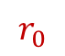
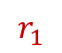
Obstacle #1: Differentiable RoI pooling
RoI pooling / SPP is just like max pooling, except that pooling regions overlap
$$r_{0}$$
$$r_{1}$$
Ross Girshick. “Fast R-CNN”. ICCV 2015.

Slide 17

Obstacle #1: Differentiable RoI pooling
RoI pooling / SPP is just like max pooling, except that pooling regions overlap
RoI pooling
$$r_{0}$$
max of input activations
$$r_{0}$$
$$r_{1}$$
Ross Girshick. “Fast R-CNN”. ICCV 2015.

Slide 18
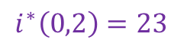
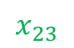
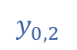
Obstacle #1: Differentiable RoI pooling
RoI pooling / SPP is just like max pooling, except that pooling regions overlap
RoI pooling
$$r_{0}$$
$$i^{∗}\left(0,2\right)=23$$
$$y_{0,2}$$
max of input activations
$$x_{23}$$
$$r_{0}$$
$$r_{1}$$
max pooling “switch” (i.e. argmax back-pointer)
Ross Girshick. “Fast R-CNN”. ICCV 2015.

Slide 19
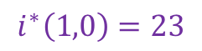
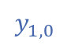
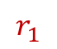
Obstacle #1: Differentiable RoI pooling
RoI pooling / SPP is just like max pooling, except that pooling regions overlap
RoI pooling
$$r_{0}$$
$$i^{∗}\left(0,2\right)=23$$
$$y_{0,2}$$
$$i^{∗}\left(1,0\right)=23$$
$$y_{1,0}$$
$$x_{23}$$
$$r_{1}$$
$$r_{0}$$
$$r_{1}$$
max pooling “switch” (i.e. argmax back-pointer)
RoI pooling
Ross Girshick. “Fast R-CNN”. ICCV 2015.

Slide 20
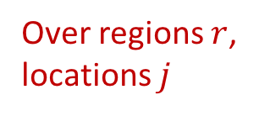
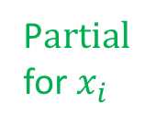
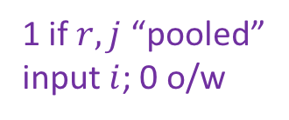
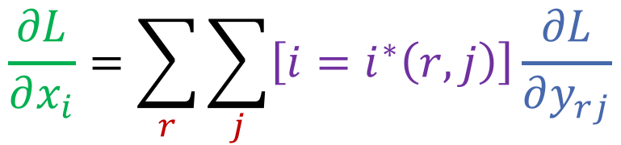
Obstacle #1: Differentiable RoI pooling
RoI pooling / SPP is just like max pooling, except that pooling regions overlap
RoI pooling
$$r_{0}$$
1 if $r, j$ “pooled”
input $i$; 0 o/w
$$i^{∗}\left(0,2\right)=23$$
$$y_{0,2}$$
$$\frac{∂L}{∂x_{i}}=\sum_{r}{\sum_{j}{\left[i=i^{∗}\left(r,j\right)\right]\frac{∂L}{∂y_{rj}}}}$$
$$i^{∗}\left(1,0\right)=23$$
$$y_{1,0}$$
P$artial$
for $x_{i}$
Over regions $r$,
locations $j$
Partial from
next layer
$$x_{23}$$
$$r_{1}$$
$$r_{0}$$
$$r_{1}$$
max pooling “switch” (i.e. argmax back-pointer)
RoI pooling
Ross Girshick. “Fast R-CNN”. ICCV 2015.

Slide 21
Obstacle #2: Making SGD steps efficient
Slow R-CNN and SPP-net use region-wise sampling to make mini-batches
Sample 128 example RoIs uniformly at random
Examples will come from different images with high probability
...
...
...
...
SGD mini-batch

Slide 22
Obstacle #2: Making SGD steps efficient
Note the receptive field for one example RoI is often very large
Worst case: the receptive field is the entire image
RoI’s receptive field
Example RoI
Example RoI

Slide 23
Obstacle #2: Making SGD steps efficient
Worst case cost per mini-batch (crude model of computational complexity)
128*600*1000 / (128*224 *224) = 12x > computation than slow R-CNN
input size for Fast R-CNN
input size for slow R-CNN
RoI’s receptive field
Example RoI
Example RoI

Slide 24
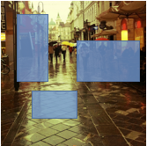
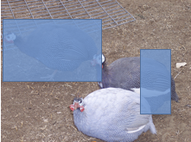
Obstacle #2: Making SGD steps efficient
Solution: use hierarchical sampling to build mini-batches
Sample a small number of images (2)
Sample many examples from each image (64)
...
...
...
...
Sample images
SGD mini-batch
Ross Girshick. “Fast R-CNN”. ICCV 2015.

Slide 25
Obstacle #2: Making SGD steps efficient
Use the test-time trick from SPP-net during training
Share computation between overlapping examples from the same image
Example RoI 1
Example RoI 1
Union of RoIs’ receptive fields
(shared computation)
Example RoI 2
Example RoI 2
Example RoI 3
Example RoI 3

Slide 26
Obstacle #2: Making SGD steps efficient
Cost per mini-batch compared to slow R-CNN (same crude cost model)
2*600*1000 / (128*224*224) = 0.19x < computation than slow R-CNN
input size for Fast R-CNN
input size for slow R-CNN
Example RoI 1
Example RoI 1
Union of RoIs’ receptive fields
(shared computaiton)
Example RoI 2
Example RoI 2
Example RoI 3
Example RoI 3

Slide 27
Obstacle #2: Making SGD steps efficient
Are the examples from just 2 images diverse enough?
Concern: examples from the sample image may be too correlated
Example RoI 1
Example RoI 1
Union of RoIs’ receptive fields
(shared computation)
Example RoI 2
Example RoI 2
Example RoI 3
Example RoI 3

Slide 28
Fast R-CNN outcome
Better training time and testing time with better accuracy than slow R-CNN or SPP-net
Training time: 84 hours / 25.5 hours / 8.75 hours (Fast R-CNN)
VOC07 test mAP: 66.0% / 63.1% / 68.1%
Testing time per image: 47s / 2.3s / 0.32s
Plus 0.2 to > 2s per image depending on proposal method
With selective search: 49s / 4.3s / 2.32s
Updated numbers from the ICCV paper based on implementation improvements
Ross Girshick. “Fast R-CNN”. ICCV 2015.

Slide 29
Experimental findings
End-to-end training is important for very deep networks
Softmax is a fine replacement for SVMs
Multi-task training is beneficial
Single-scale testing is a good tradeoff (noted by Kaiming)
Fast training and testing enables new experiments
Comparing proposals

Slide 30
The benefits of end-to-end training
Using 1 scale
Using 5 scales
Model L = VGG16
Training layers >= conv3_1 yields 1.4x faster SGD steps, small mAP loss
Ross Girshick. “Fast R-CNN”. ICCV 2015.

Slide 31
Softmax is a good SVM replacement
VOC07 test mAP
L = VGG16, M = VGG_CNN_M_1024, S = Caffe/AlexNet
Ross Girshick. “Fast R-CNN”. ICCV 2015.

Slide 32
Multi-task training is beneficial
L = VGG16
Ross Girshick. “Fast R-CNN”. ICCV 2015.

Slide 33
Single-scale testing a good tradeoff
L = VGG16, M = VGG_CNN_M_1024, S = Caffe/AlexNet
Ross Girshick. “Fast R-CNN”. ICCV 2015.

Slide 34
Direct region proposal evaluation
VGG_CNN_M_1024
Training takes < 2 hours
Fast training makes these experiments possible
Ross Girshick. “Fast R-CNN”. ICCV 2015.

Slide 35
Part 2: Faster R-CNN training
Two algorithms for training Faster R-CNN
Alternating optimization
Presented in our NIPS 2015 paper
Approximate joint training
Unpublished work, available in the py-faster-rcnn Python implementation https://github.com/rbgirshick/py-faster-rcnn
Discussion of exact joint training
Shaoqing Ren, Kaiming He, Ross Girshick, Jian Sun. “Faster R-CNN: Towards Real-Time Object Detection with Region Proposal Networks”. NIPS 2015.

Slide 36

What is Faster R-CNN?
classifier
RoI pooling
Presented in Kaiming’s section
Review: Faster R-CNN = Fast R-CNN + Region Proposal Networks
Does not depend on an external region proposal algorithm
Does object detection in a single forward pass
proposals
Region Proposal Network
feature map
CNN
image

Slide 37
Training goal: Share features
classifier
RoI pooling
RPN
proposals
proposals
from any algorithm
Region Proposal Network
feature map
feature map
CNN A
CNN B
Goal: share so CNN A == CNN B
image
image
CNN A + RPN
CNN B + detector

Slide 38
Training method #1: Alternating optimization
# Let M0 be an ImageNet pre-trained network
train_rpn(M0) → M1 # Train an RPN initialized from M0, get M1
generate_proposals(M1) → P1 # Generate training proposals P1 using RPN M1
train_fast_rcnn(M0, P1) → M2 # Train Fast R-CNN M2 on P1 initialized from M0
train_rpn_frozen_conv(M2) → M3 # Train RPN M3 from M2 without changing conv layers
generate_proposals(M3) → P2
train_fast_rcnn_frozen_conv(M3, P2) → M4 # Conv layers are shared with RPN M3
return add_rpn_layers(M4, M3.RPN) # Add M3’s RPN layers to Fast R-CNN M4

Slide 39
Training method #1: Alternating optimization
Motivation behind alternating optimization
Not based on any fundamental principles
Primarily driven by implementation issues and the NIPS deadline ☺️
However, it was unclear if joint training would “just work”
Fast R-CNN was always trained on a fixed set of proposals
In joint training, the proposal distribution is constantly changing

Slide 40
Training method #2: Approx. joint optimization
Write the network down as a single model and just train it
Train with SGD as usual
Even though the proposal distribution changes this just works
Implementation challenges eased by writing various modules in Python

Slide 41
One net, four losses
Classification loss
Bounding-box regression loss
…
Classification loss
Bounding-box regression loss
RoI pooling
proposals
Region Proposal Network
feature map
CNN
image

Slide 42
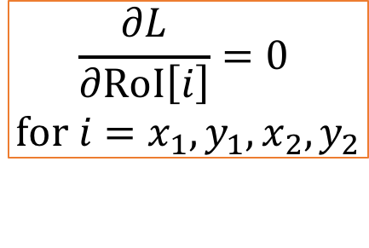
Training method #2: Approx. joint optimization
Why is this approach approximate? roi_pooling(conv_feat_map, RoI)
Function input 1
Conv feature map
RoI pooling layer
Function input 2
fc layers …
Region of Interest (RoI)
$$\frac{∂L}{∂\text{RoI}\left[i\right]}=0$$
$$\text{for} i=x_{1},y_{1},x_{2},y_{2}$$
In Fast R-CNN function input 2 (RoI) is a constant,
everything is OK

Slide 43
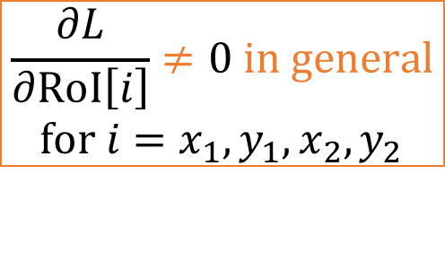
Training method #2: Approx. joint optimization
Why is this approach approximate? roi_pooling(conv_feat_map, RoI)
Function input 1
Conv feature map
RoI pooling layer
Function input 2
fc layers …
Region of Interest (RoI)
$$\frac{∂L}{∂\text{RoI}\left[i\right]}≠0 \text{in} \text{general}$$
$$\text{for} i=x_{1},y_{1},x_{2},y_{2}$$
In Faster R-CNN function input 2 (RoI) depends on the input image

Slide 44
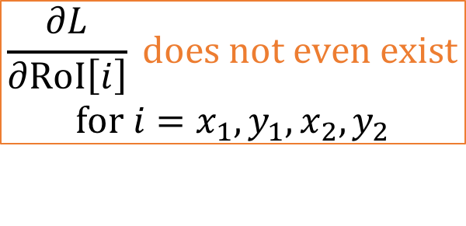
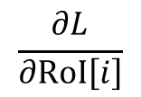
Training method #2: Approx. joint optimization
Why is this approach approximate? roi_pooling(conv_feat_map, RoI)
Function input 1
Conv feature map
RoI pooling layer
Function input 2
fc layers …
Region of Interest (RoI)
$$\frac{∂L}{∂\text{RoI}\left[i\right]}$$
$$\frac{∂L}{∂\text{RoI}\left[i\right]} \text{does} \text{not} \text{even} \text{exist}$$
$$\text{for} i=x_{1},y_{1},x_{2},y_{2}$$
However, is actually undefined,
roi_pooling() is not differentiable w.r.t. RoI

Slide 45
Training method #2: Approx. joint optimization
What happens in practice?
We ignore the undefined derivatives of loss w.r.t. RoI coordinates
Run SGD with this “surrogate” gradient
This just works
Why?
RPN network receives direct supervision
Error propagation from RoI pooling might help, but is not strictly needed

Slide 46
Faster R-CNN exact joint training
Modify RoI pooling so that it’s a differentiable function of both the input conv feature map and input RoI coordinates
One option (untested, theoretical)
Use a differentiable sampler instead of max pooling
If RoI pooling uses bilinear interpolation instead of max pooling, then we can compute a derivatives w.r.t. the RoI coordinates
See: Jaderberg et al. “Spatial Transformer Networks” NIPS 2015.

Slide 47
Experimental findings (py-faster-rcnn implementation)
Approximate joint training gives similar mAP to alternating optimization
VOC07 test mAP
Alt. opt.: 69.9%
Approx. joint: 70.0%
Approximate joint training is faster and simpler
Alt. opt.: 26.2 hours
Approx. joint: 17.2 hours

Slide 48

Code pointers
Fast R-CNN (Python): https://github.com/rbgirshick/fast-rcnn
Faster R-CNN (matlab): https://github.com/ShaoqingRen/faster_rcnn
Faster R-CNN (Python): https://github.com/rbgirshick/py-faster-rcnn
Now includes code for approximate joint training
Reproducible research – get the code!

Slide 49
Extra slides follow

Slide 50
Fast R-CNN unified network
B full images input: B x 3 x H x W
(e.g., B = 2, H = 600, W = 1000)
Sampled class labels: 128 x 21
Classification loss
(log loss)
+
Bounding-box regression loss
(“Smooth L1” / Huber)
Sampled box regression
targets: 128 x 84
Sampled RoIs: 128 x 5
Ross Girshick. “Fast R-CNN”. ICCV 2015.

Slide 51
Fast R-CNN unified network
B full images input: B x 3 x H x W
(e.g., B = 2, H = 600, W = 1000)
Sampled class labels: 128 x 21
Classification loss
(log loss)
+
Bounding-box regression loss
(“Smooth L1” / Huber)
Sampled box regression
targets: 128 x 84
Sampled RoIs: 128 x 5
Ross Girshick. “Fast R-CNN”. ICCV 2015.

